Slide 2
Composition of the Urinary System

Slide 3
There are three major regions of the kidney:
Renal cortex
Renal medulla
Renal pelvis

Slide 5
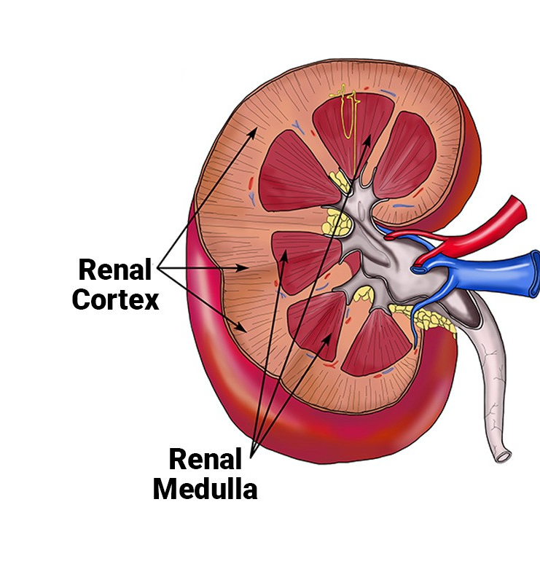
Renal Cortex
The kidneys are surrounded by a renal cortex, a layer of tissue that is also covered by renal fascia (connective tissue) and the renal capsule. The renal cortex is granular tissue due to the presence of nephrons—the functional unit of the kidney—that are located deeper within the kidney, within the renal pyramids of the medulla.

Slide 6
Renal Medulla
The medulla is the inner region of the parenchyma of the kidney. The medulla consists of multiple pyramidal tissue masses, called the renal pyramids, which are triangle structures that contain a dense network of nephrons. At one end of each nephron, in the cortex of the kidney, is a cup-shaped structure called the Bowman’s capsule. It surrounds a tuft of capillaries called the glomerulus that carries blood from the renal arteries into the nephron, where plasma is filtered through the capsule.
Renal Pelvis
The renal pelvis contains the hilium. The hilum is the concave part of the bean-shape where blood vessels and nerves enter and exit the kidney; it is also the point of exit for the ureters—the urine-bearing tubes that exit the kidney and empty into the urinary bladder. The renal pelvis connects the kidney to the rest of the body.

